Slide 1
Heart Attack Prediction

Slide 2
Introduction
Overview of the Project:
This project involves building a predictive model for heart attack prediction.
Objective:
To develop a robust model that can accurately predict the class of unseen data instances.

Slide 3
Data Import and Preprocessing
Data Source: https://www.kaggle.com/datasets/juledz/heart-attack-prediction/data
Preprocessing Steps:
Handling missing values

Slide 4
Data Exploration and Visualization
Exploratory Data Analysis (EDA) helps in understanding data distribution and relationships.
Key Insights: Performed Gender Distribution, Chest pain type distribution, Cholesterol Distribution, Maximum Heart Rate distribution
Visualizations:
Various plots were used to analyse the key insights.

Slide 5
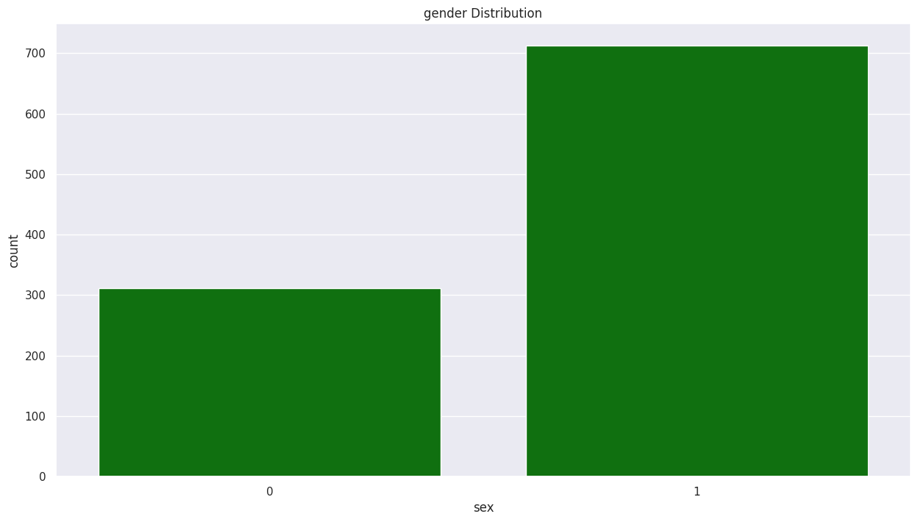
Gender Distribution

Slide 6
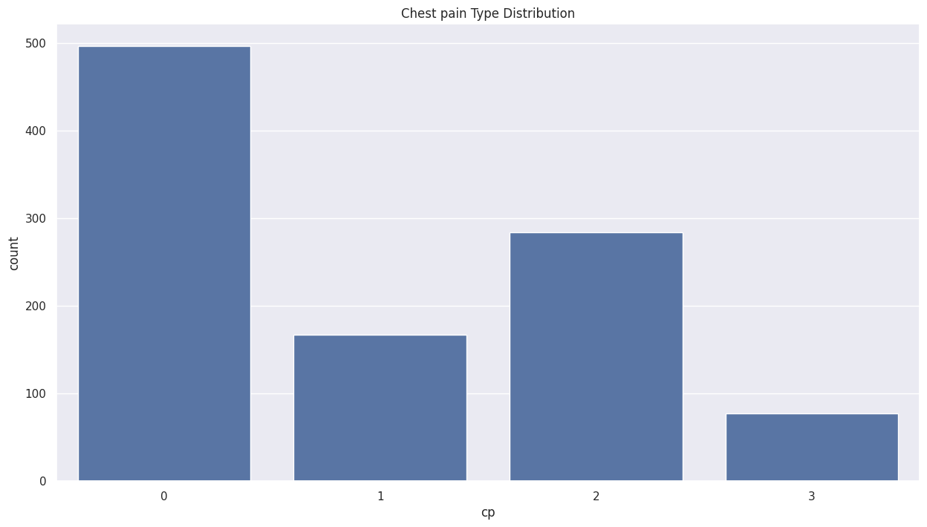
Chest Pain Type Distribution

Slide 7
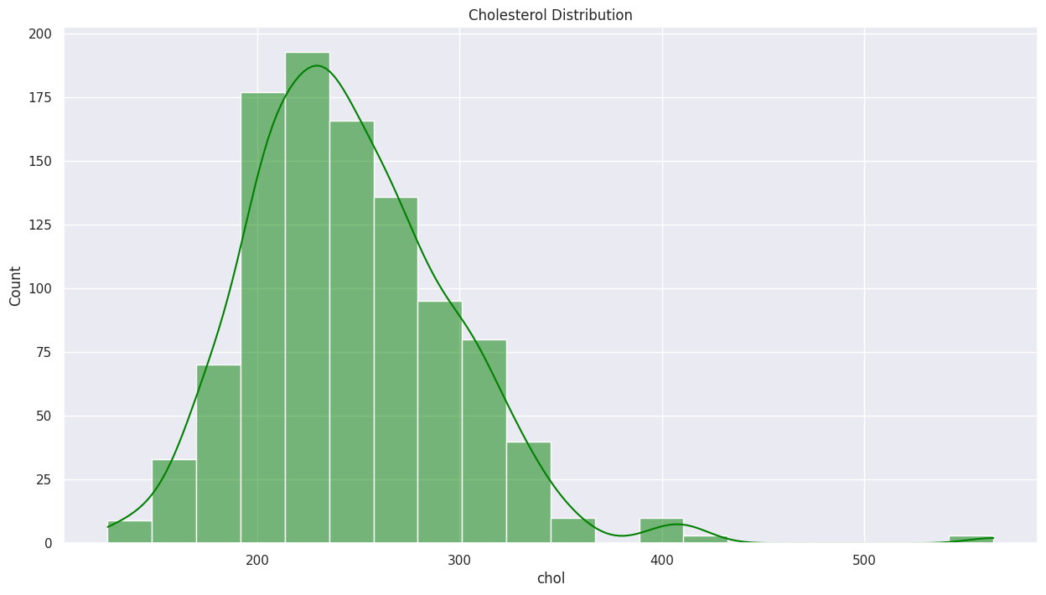
Cholesterol Distribution

Slide 8
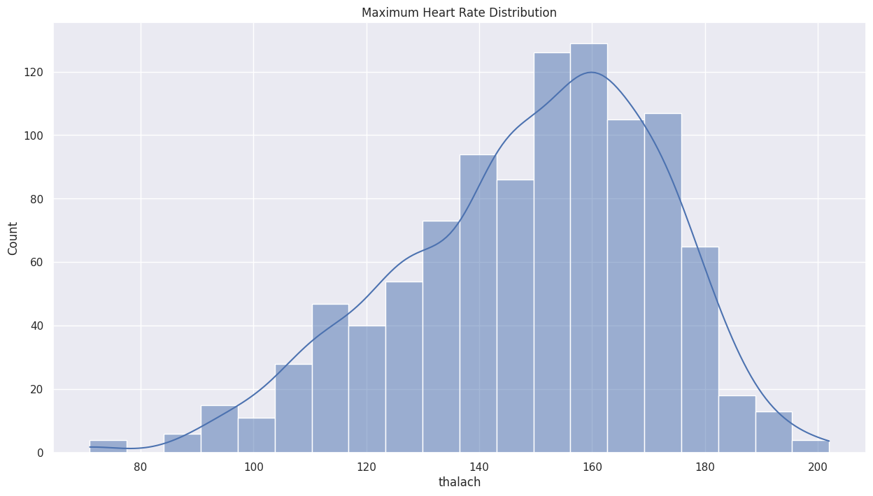
Maximum Heart Rate Distribution

Slide 9
Feature Engineering
Created Features:
Age Bins – Mapping the values of age: 25-29 = 0,30-34 = 1 and so on...
Importance of Features:
Feature engineering enhances model performance by providing relevant input to the model.

Slide 10
Model Training
Algorithms Used:
Logistic Regression
Naïve Bayes
SVM
K Nearest Neighbours
Decision Tree
Random Forest
XGBoot
Neural Network
Training Process:
Models were trained using cross-validation and hyperparameter tuning to optimize performance.

Slide 11
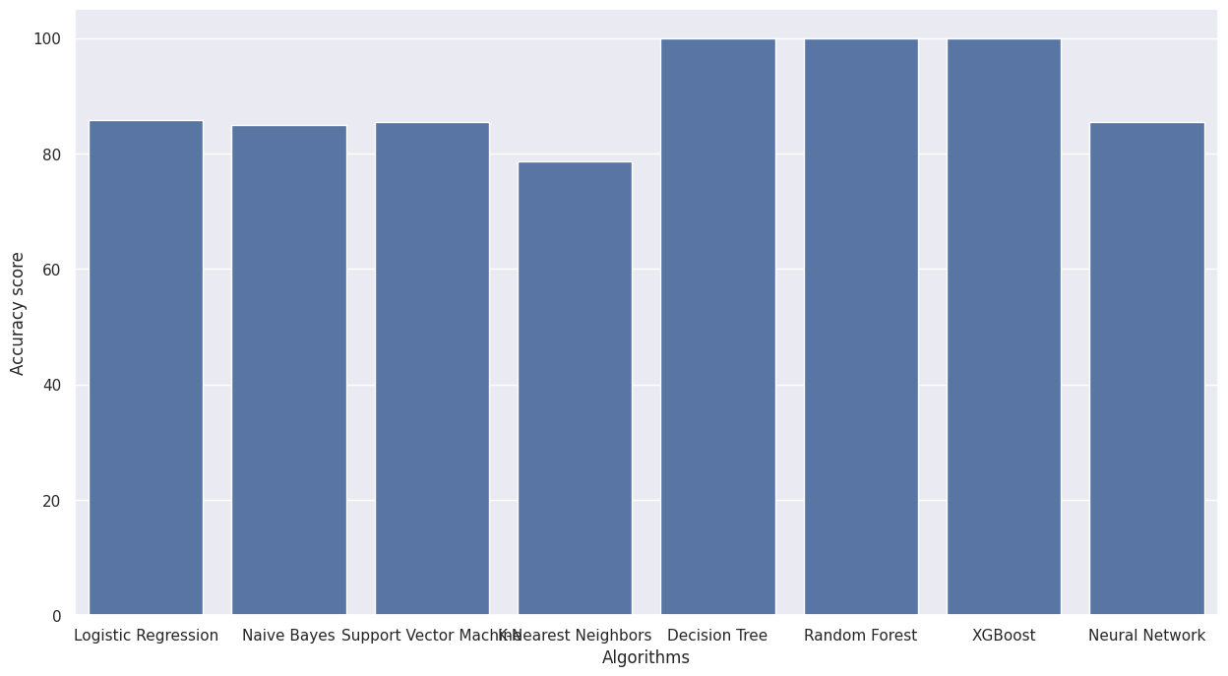
Model Evaluation
Evaluation Metrics:
Accuracy

Slide 12
Model Deployment
Predicting Unseen Data:
The final model was used to predict outcomes for new data instances.
Sample Predictions:
Predicted classes for sample data: [0, 1, 0]

Slide 13
Conclusion
Summary of Findings:
The project successfully developed a predictive model with high accuracy.
Future Work:
Further improvements can be made by incorporating more data and experimenting with advanced algorithms.

